Slide 1
TRAFFIC SIGNAL IDENTIFICATION USING CONVOLUTION NEURAL NETWORKS
BY:-
VAMSEE BALLEDA
BATCH NO:- 195

Slide 2
Abstract
We propose an approach for traffic sign detection based on Convolutional Neural Networks (CNN). We first transform the original image into the gray scale image by using support vector machines, then use convolutional neural networks with fixed and learnable layers for detection and recognition. The fixed layer can reduce the amount of interest areas to detect, and crop the boundaries very close to the borders of traffic signs. The learnable layers can increase the accuracy of detection significantly. Besides, we use bootstrap methods to improve the accuracy and avoid overfitting problem. In the German Traffic Sign Detection Benchmark, we obtained competitive results, with an area under the precision-recall curve(AUC) of 99.73% in the category “Danger”, and an AUC of 97.62% in the category “Mandatory”.

Slide 3
PROBLEM STATEMENT
The proposed system consists of the following two main stages: detection and recognition. The complete set of road signs used in our training data and recognized by the system
The traffic symbols from the image are given as input to the system then system finds MSERs from MSERs system genetrates bounding box. Considering those bounding boxes system finds shapes and classifies accurate traffic symbol. Finaly system notifies that symbol to driver with audio

Slide 4
GERMAN TRAFFIC SIGN DATASET
The German traffic signs detection dataset is provided here. The dataset consists of 39209 images with 43 different classes. The images are distributed unevenly between those classes and hence the model may predict some classes more accurately than other classes.
We can populate the dataset with various image modifying techniques such as rotation, colour distortion or blurring the image. We will be training the model on the original dataset and will see the accuracy of the model. Then we’ll be adding more data and making each class even and check the model’s accuracy.

Slide 5
MODULES USED
Os
Numpy
Pandas
Matplotlib(pyplot)
Random
Cv2
Sklearn
Tensorflow
Urllib.Request
Zipfile
Pickle
Warnings
Glob

Slide 6
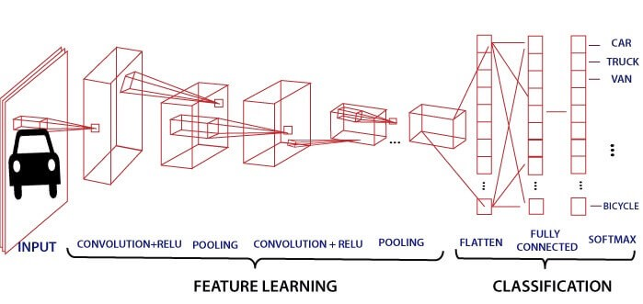
CNN MODEL

Slide 7
MODEL
Number Of Training Examples = 34799
Number Of Testing Examples = 12630
Number Of Validation Examples = 4410
Image Data Shape = (32, 32, 3)
Number Of Classes = 43
No Of Epochs = 25
Batch Size = 128
Accuracy = 0.817 - 0.978
https://colab.research.google.com/drive/1uX1SbgzmF0_tF9IW8bBGzKeTB1A3tgbM#scrollTo=bfUQ-pPft_ac

Slide 8
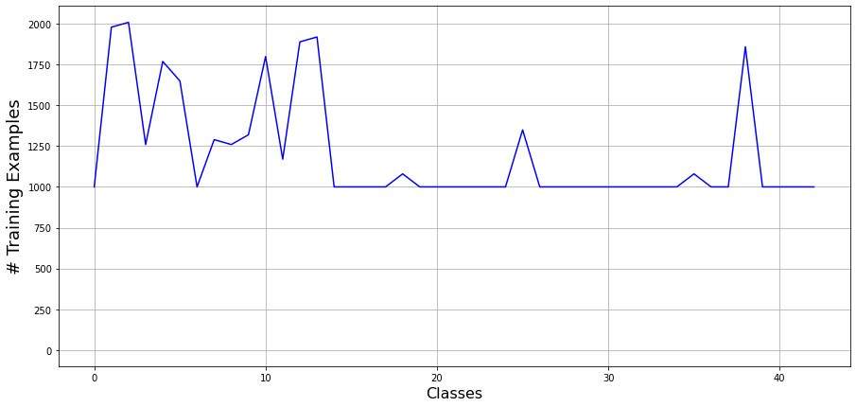
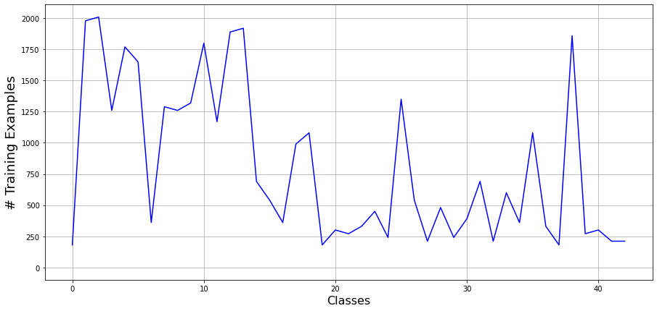

Slide 9


